Slide 1
Artificial Intelligence for Games
Week 10 – Gesture Recognition
Steve Rabin
For help on projects, email everyone (select and copy this string from the start of any class PowerPoint):
steve.rabin@gmail.com, p.jiankai@digipen.edu, b.hsu@digipen.edu, zak.s@digipen.edu, keaton.sullivan@digipen.edu, john.tseng@digipen.edu, a.roulst@digipen.edu
TAs: Jian Kai Phua, Brandon Hsu, Zak Stephenson, Keaton Sullivan, John Tseng, Andrew Roulst

Slide 2
Gesture Recognition
Record gesture
  Must know when gesture starts and stops!
  Holding a button or passing a threshold
Process Gesture
  Position independence
  Size independence
  Irregularities
  Redundant data
  Feature extraction
Apply matching algorithm

Slide 3
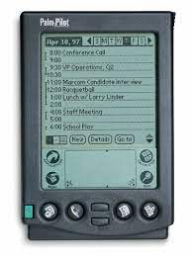
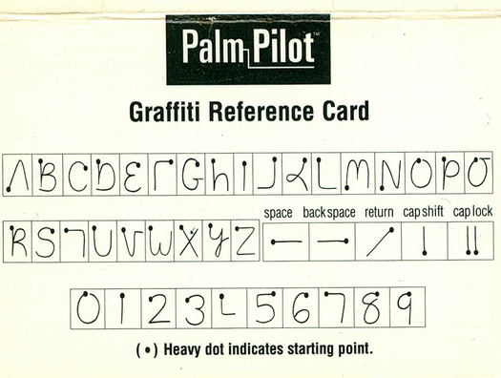

Slide 4
processing
normalize

Slide 5
Gesture Recognition: Nearest Neighbor
Example 1
Example 2
Example 3
Which example best
matches the player's???
Player Move

Slide 6
error = 0°
error = 90°
error = 90°
Example 1
Example 2
Example 3

Slide 7
error = 45°
error = 45°
error = 0°
Example 1
Example 2
Example 3

Slide 8
error = 45°
error = 0°
error = 0°
Example 1
Example 2
Example 3

Slide 9
0+45+45=90
90+45+0=135
90+0+0=90
Example 1
Example 2
Example 3
Player Move

Slide 10
0+45²+45²=4050
90²+45²+0=10125
90²+0+0=8100
Example 1
Example 2
Example 3
Square the
individual error,
then sum!!!
Player Move
Notes:
Big error penalize more heavily
Squaring it allow the noise to be more apparent

Slide 11
Gesture Recognition
Compare vectors and perform nearest neighbor

Slide 12
Gesture Recognition Demo

Slide 13
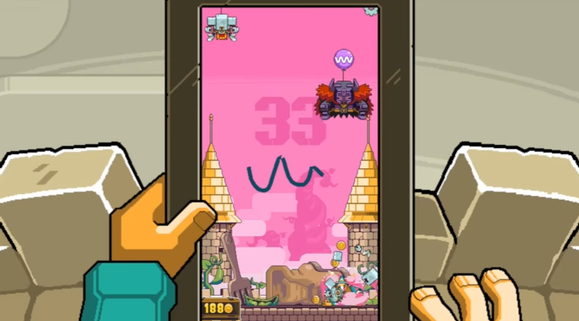
https://www.youtube.com/watch?v=bTTAmwbz864

Slide 14
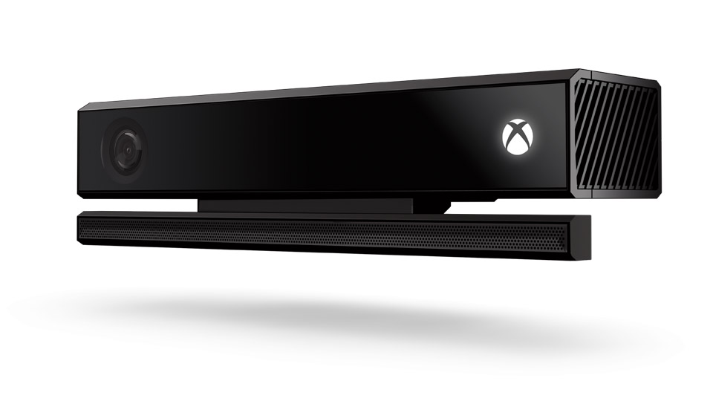
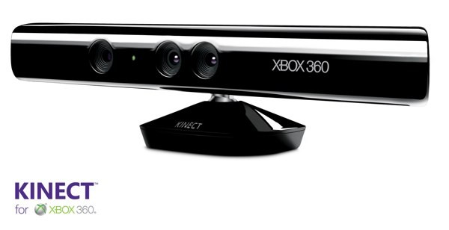
Kinect

Slide 15
Kinect for Xbox 360
$149.99 at retail
  $56 worth of parts
    $17 for PrimeSense motion detector
$500M ad campaign during 1st Christmas
  Ad spending was $100 per Kinect sold

Slide 16
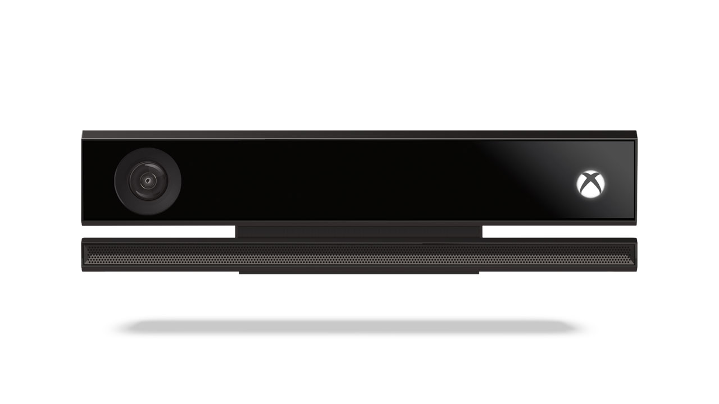
Kinect One
3x fidelity
IR sensor (no visible light)
60% wider field of vision
  Closest 3ft vs 6ft
Detect heart rate, facial expression
Position and orientation of 25 joints
  Weight put on each limb

Slide 17
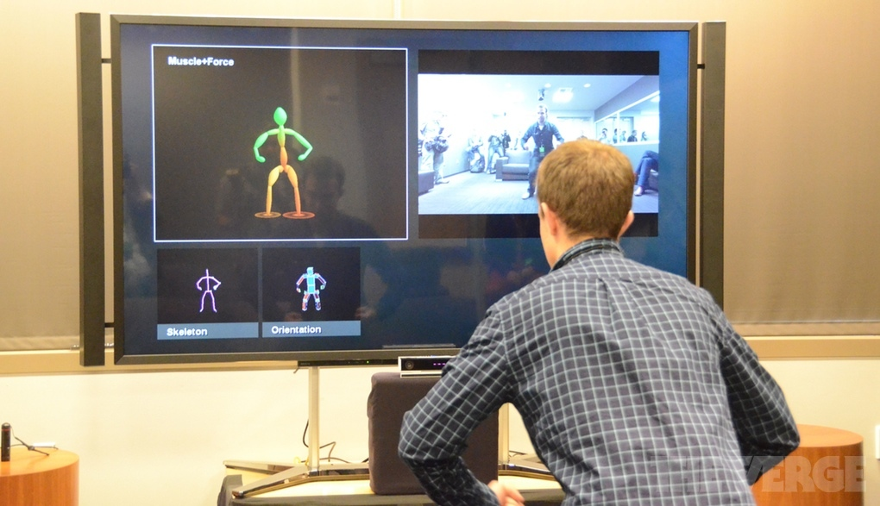
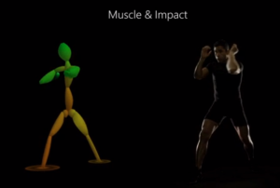

Slide 18
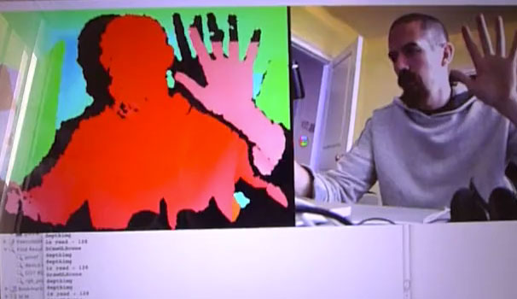
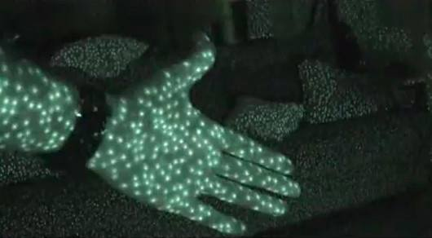

Slide 19
